Slide 1

High Impact Skills Development Program
in Artificial Intelligence, Data Science, and Blockchain
Module 6: Data Mining Using SQL & NoSQL
Lecture 1: Data Manipulation from Multiple Tables
Instructor: Dr. Muhammad Bilal
Assistant Professor, SEECS, NUST

Slide 2
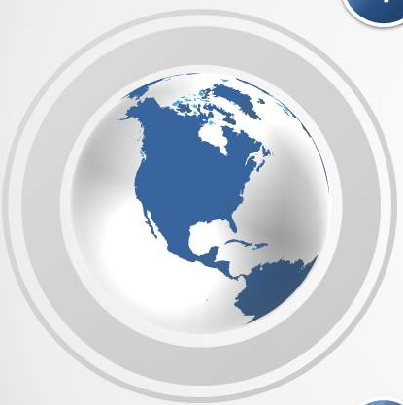

Contents
Introduction
Data Mining
Metadata Analysis
SQL for Data Retrieval
Data from Multiple Entities

Slide 3
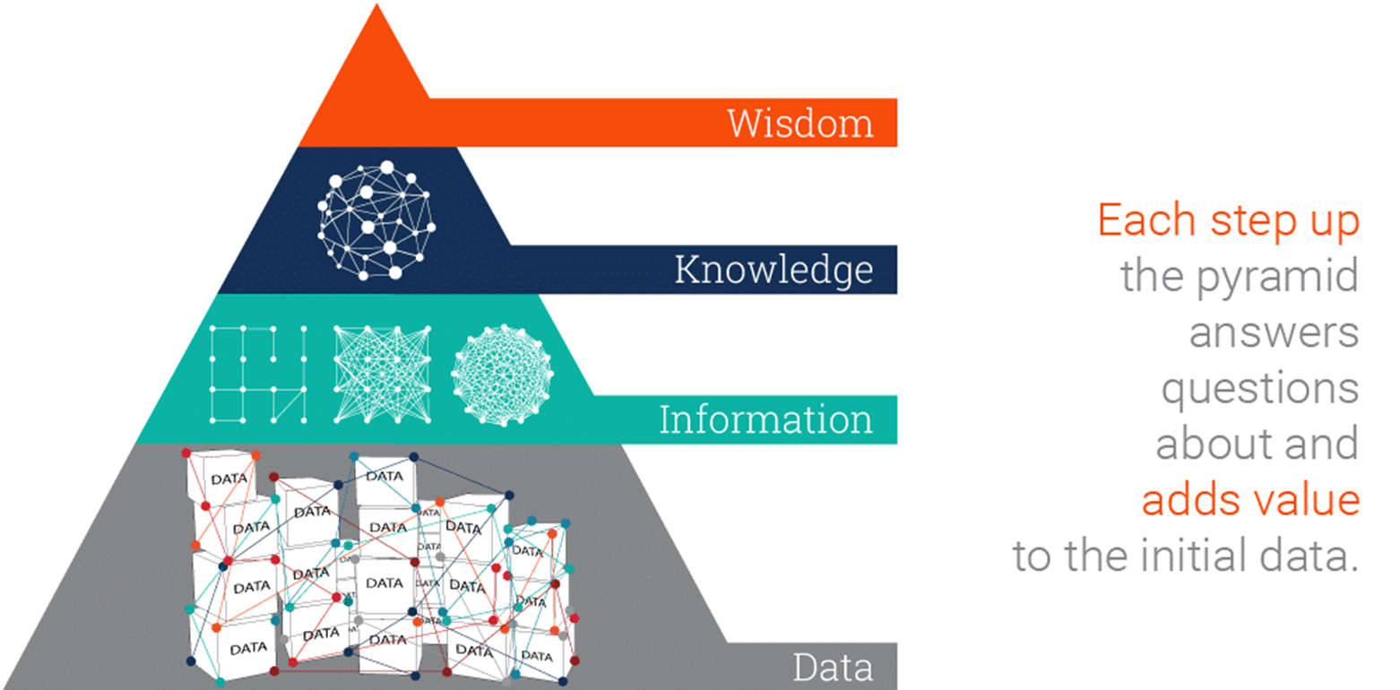

Introduction

Slide 4
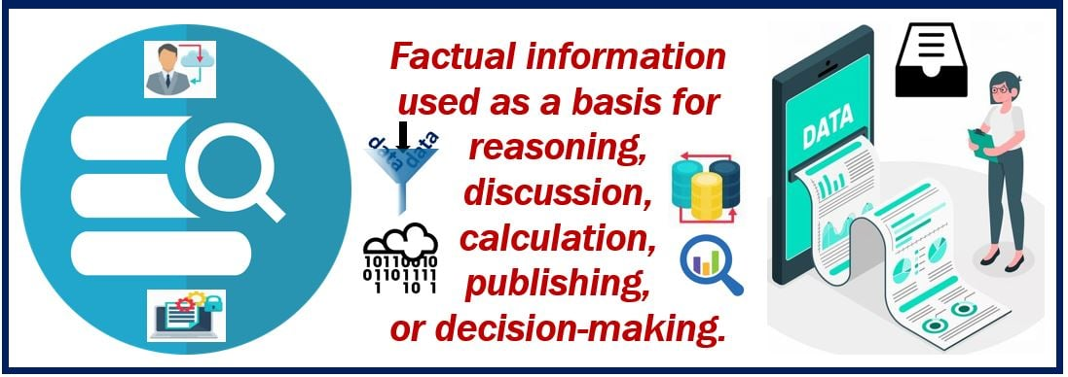
Data

Slide 5
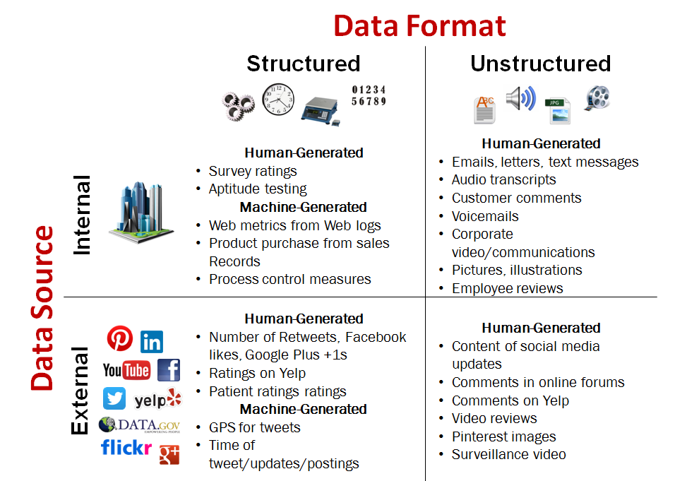
Data

Slide 6
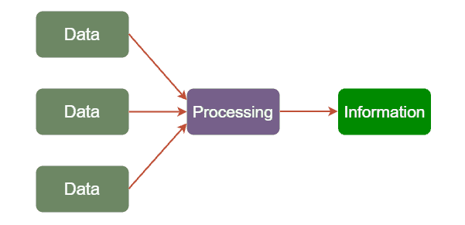
Information
Information is an abstract concept that refers to that which has the power to inform. At the most fundamental level, information pertains to the interpretation (perhaps formally) of that which may be sensed, or their abstractions.

Slide 7
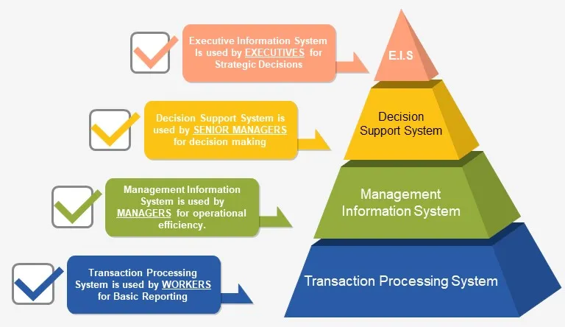
Information Management Systems
An Information Management System (IMS) refers to any framework of software that facilitates the collection, storage, organization, and distribution of information.

Slide 8

Knowledge
Facts, information, and skills gained through experience or education; the theoretical or practical understanding of a subject.

Slide 9
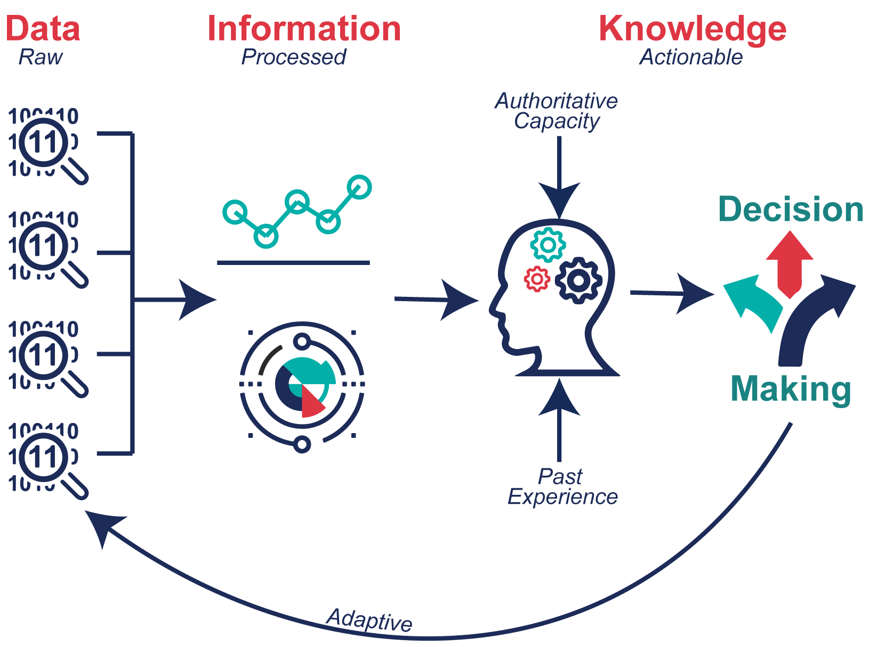
Data-Information-Knowledge

Slide 10
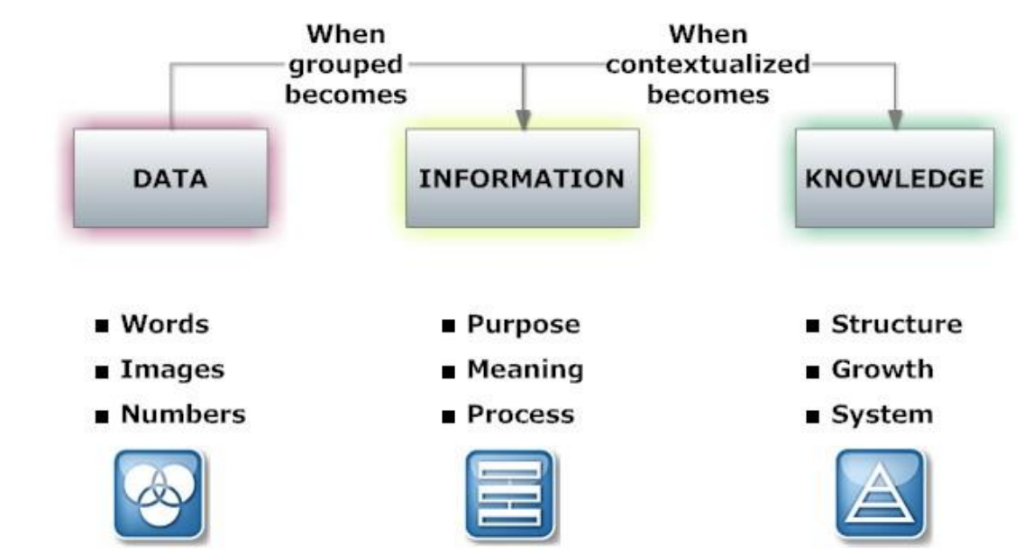
Data-Information-Knowledge
Goal: Wisdom to take decision

Slide 11
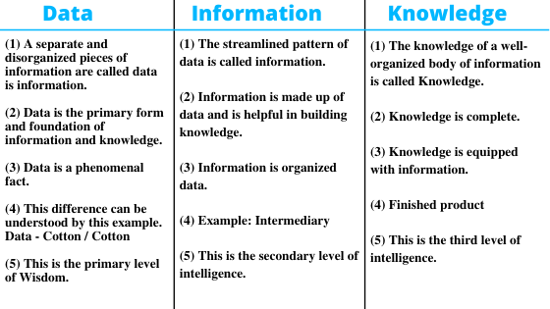
Data-Information-Knowledge

Slide 12
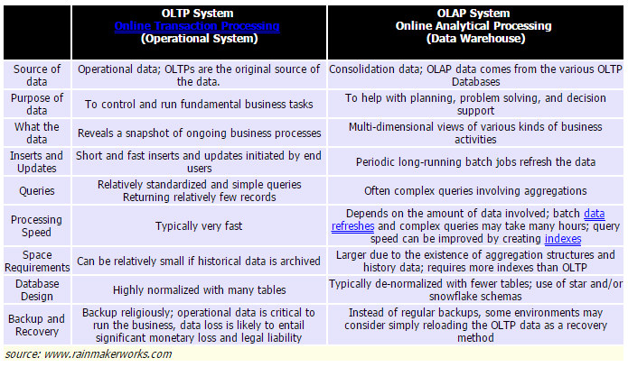

OLTP vs OLAP
Focus

Slide 13
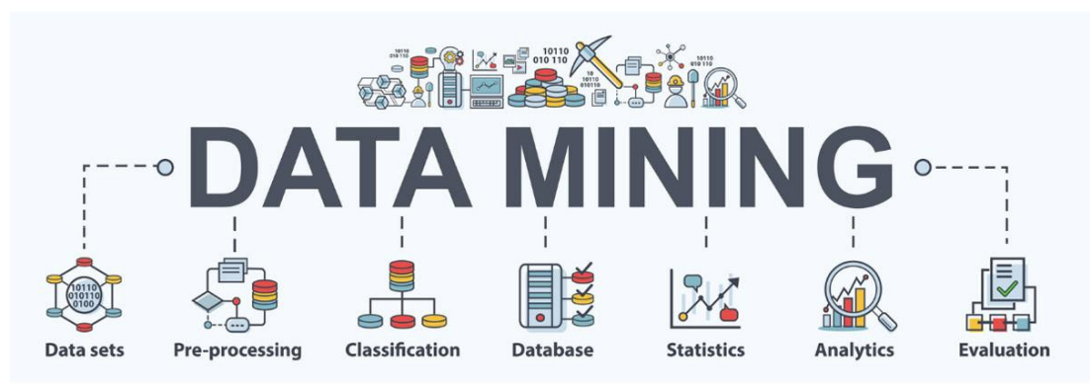

Data Mining
Data mining is the process of understanding data through cleaning raw data, finding patterns, creating models, and testing those models. It includes statistics, machine learning, and database systems

Slide 14
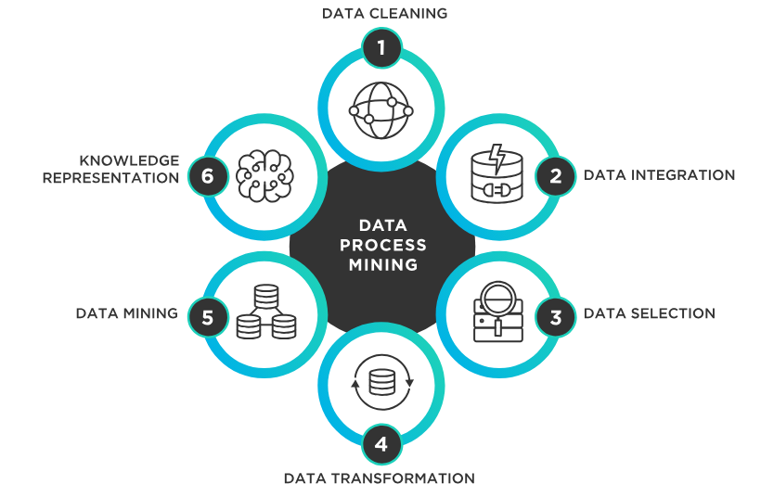
Data Mining Process
Cleaning
Integration
Selection
Transformation
Mining
Knowledge representation

Slide 15
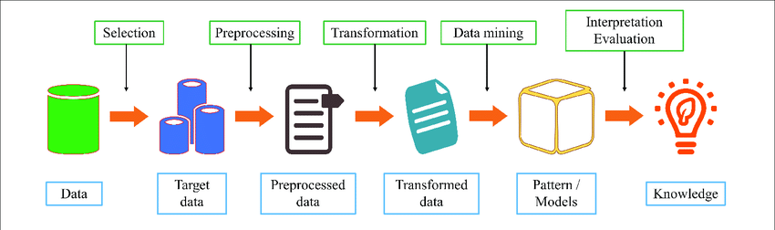
Steps of Data Mining

Slide 16
Data Selection
Using Structured Query Language SQL

Slide 17
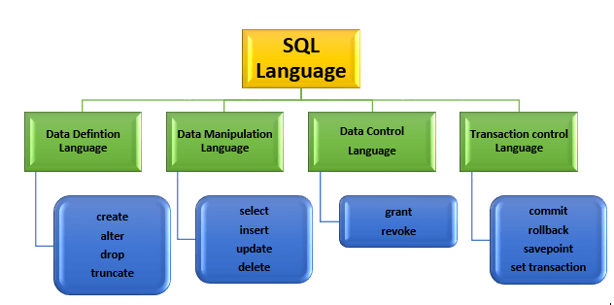
Structured Query Language

Slide 18
Data Selection
Data Selection
Single Source
Multiple Sources
Constraint on Data Selection
Single Row Data Constraint
Multiple Row Data Constraint
Data Representation
Expression
Aliases
Reordering

Slide 19
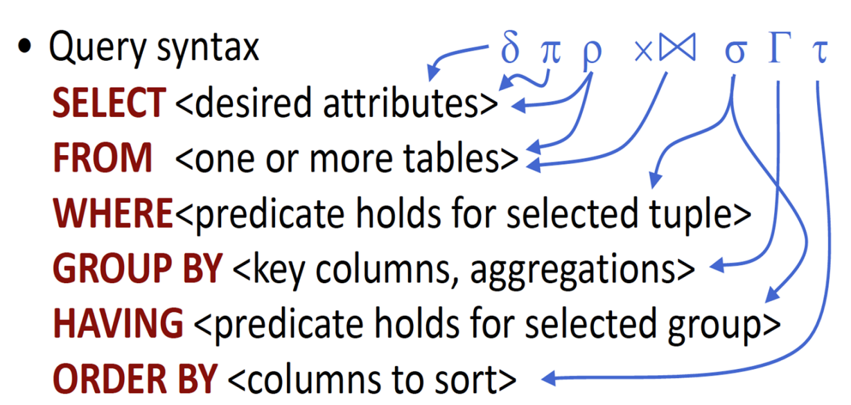
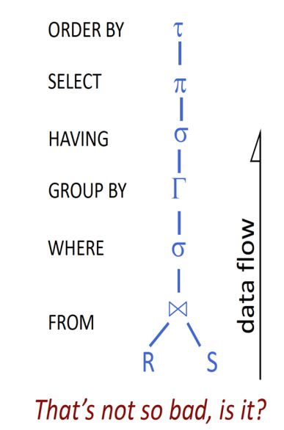
Data Selection

Slide 20
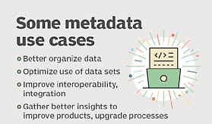
Metadata exploration
Metadata:
Data about data

Slide 21
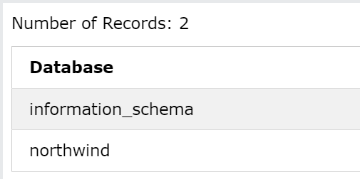
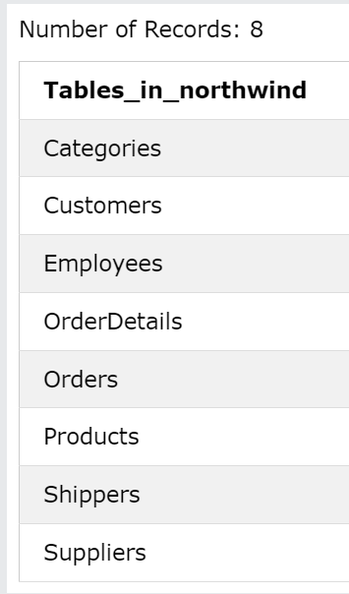
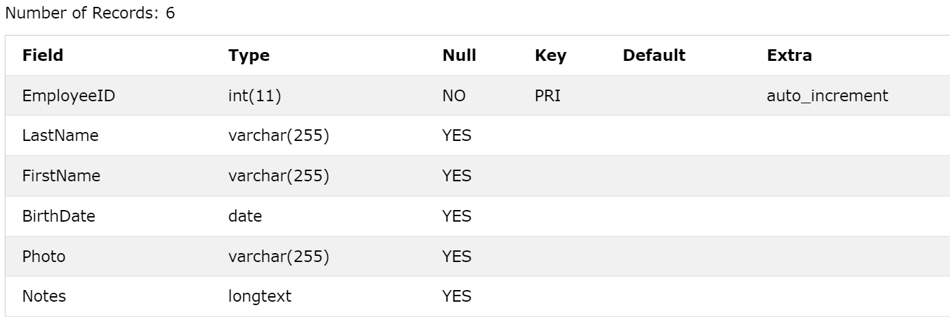
Metadata exploration
Show Databases
Show Tables
Describe Employees

Slide 22
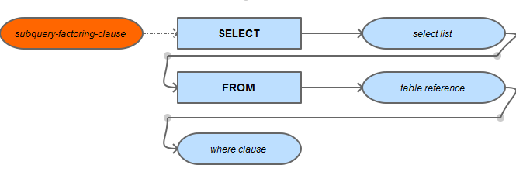
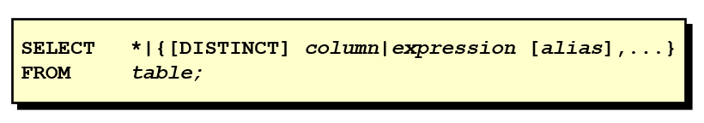
SELECT Clause

Slide 23
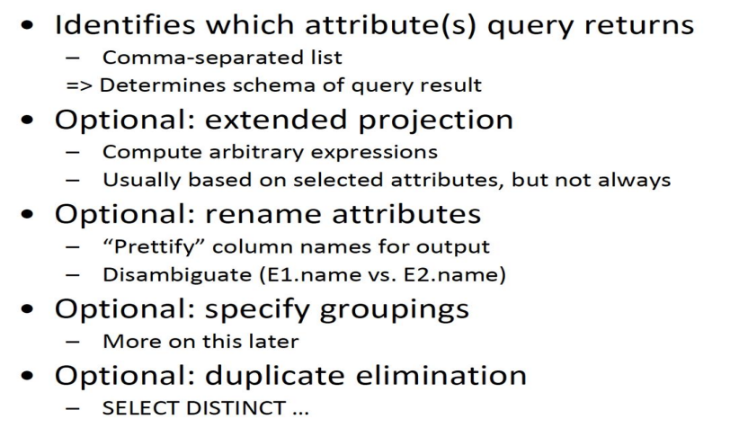
SELECT Clause

Slide 24
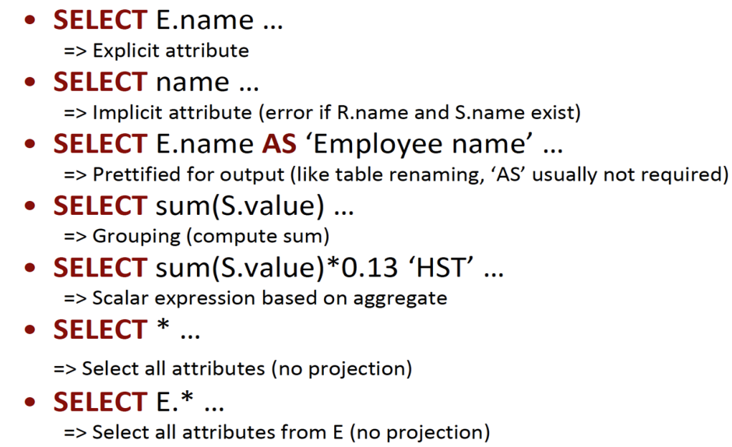
SELECT Clause

Slide 25
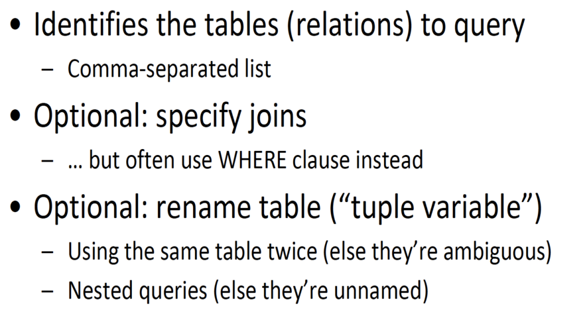
FROM Clause

Slide 26
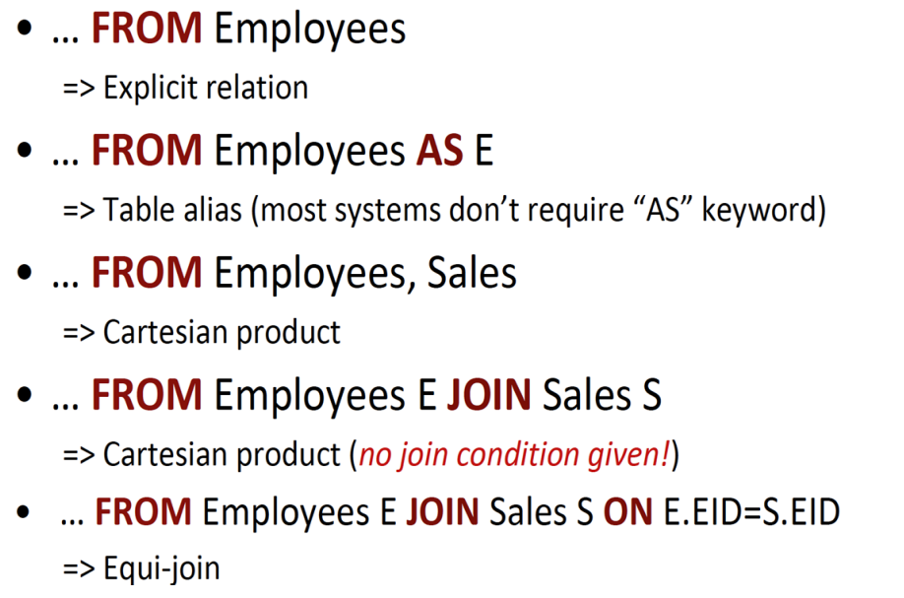
FROM Clause

Slide 27
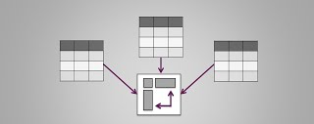
Data From Multiple Entities

Slide 28


Slide 29

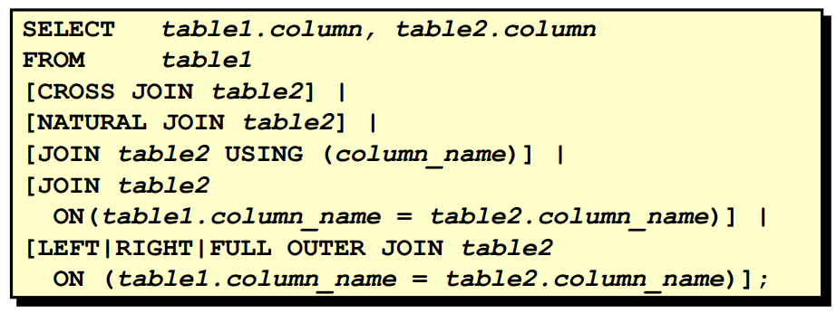

Slide 30
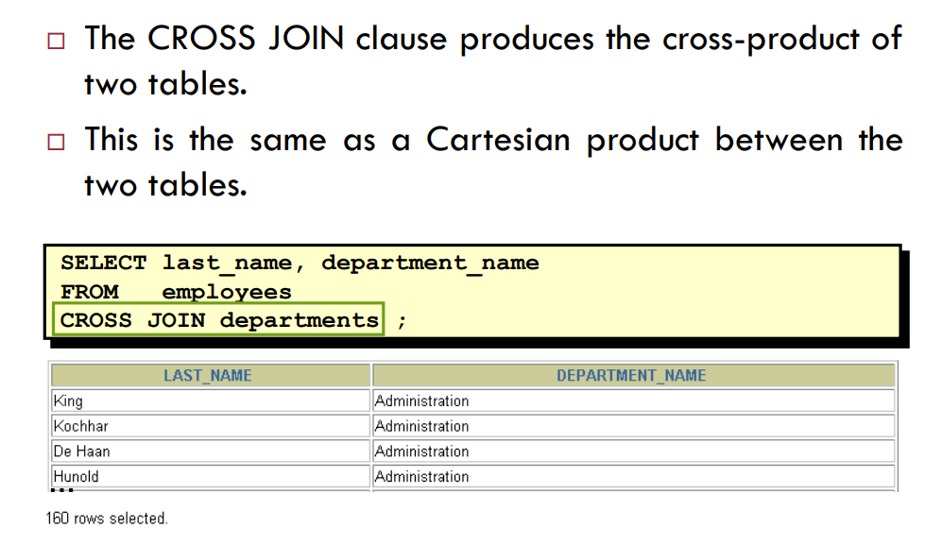
Cartesian Product

Slide 31
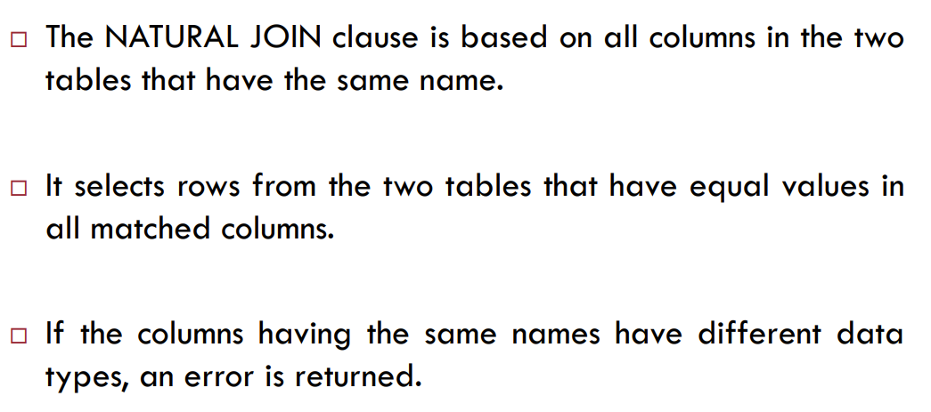
Natural Joins

Slide 32
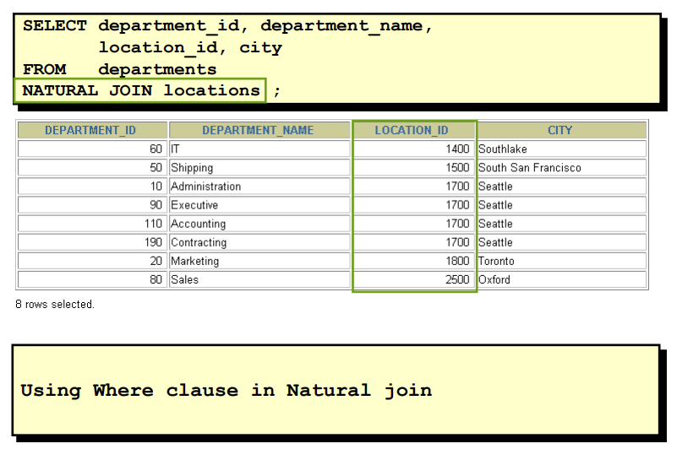
Retrieving through Natural Join

Slide 33
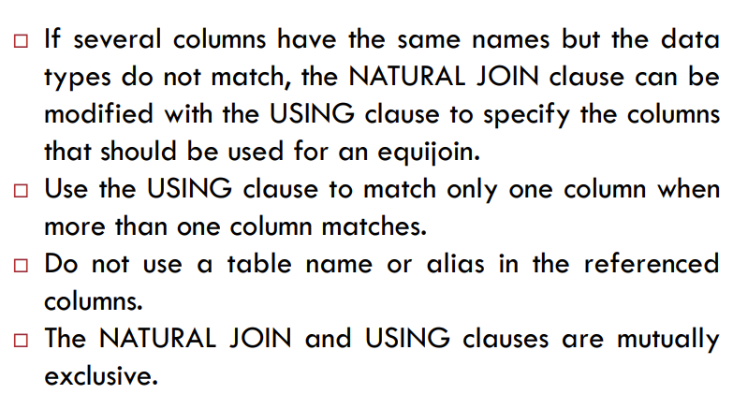
Join with Using Clause

Slide 34
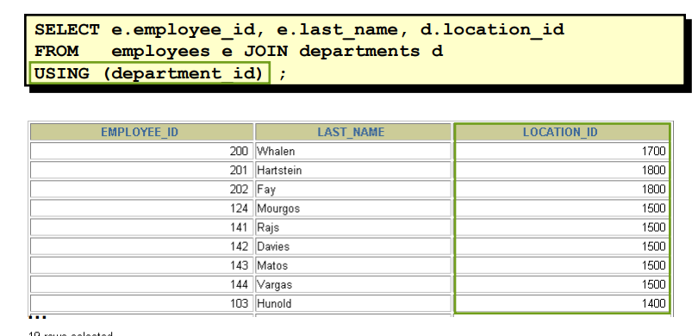
Join with Using Clause

Slide 35
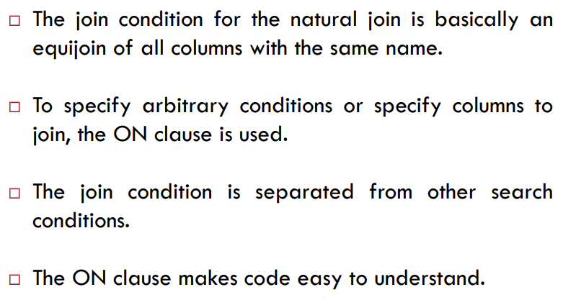
Join with ON Clause

Slide 36
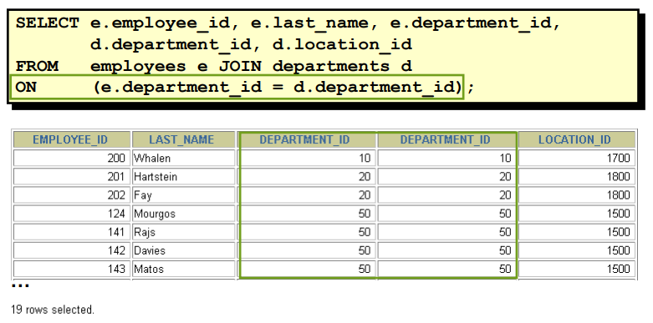
Join with ON Clause

Slide 37
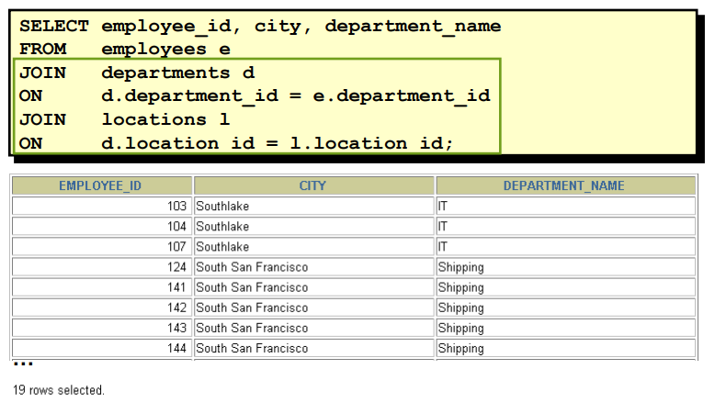
Join with ON Clause

Slide 38
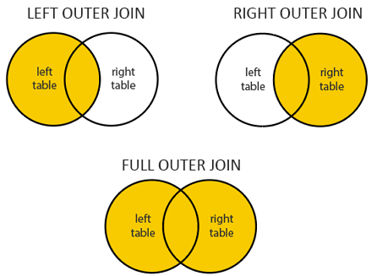
Outer Join

Slide 39
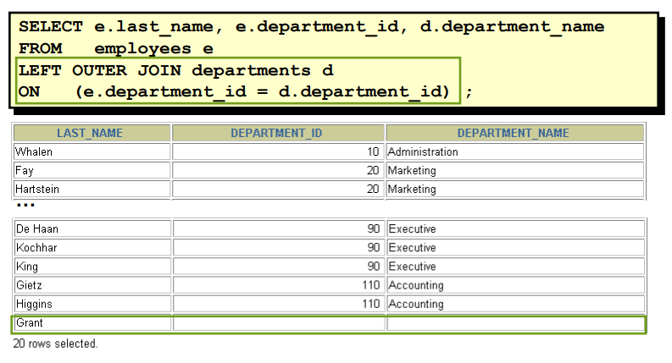
Left Outer Join

Slide 40
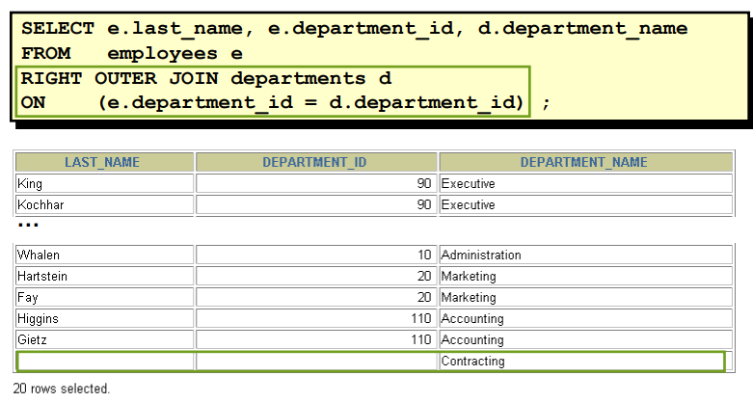
Right Outer Join

Slide 41
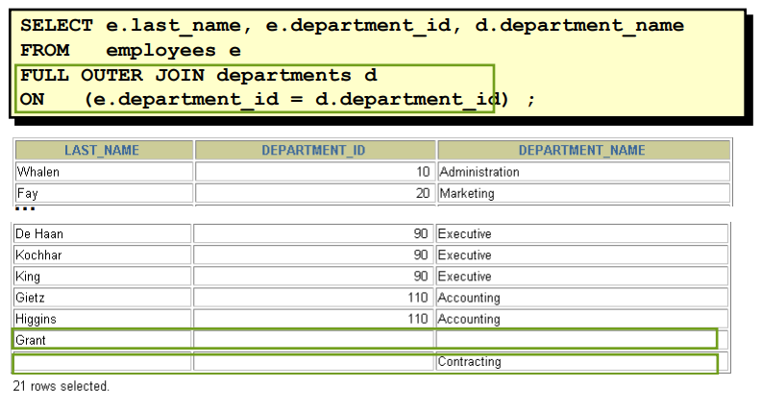
Full Outer Join

Slide 42
Conclusion
We discussed following topics
Data-Information-Knowledge
Data Mining Process
Structure Query Language
Data selection
Single source
Multiple sources

Slide 43
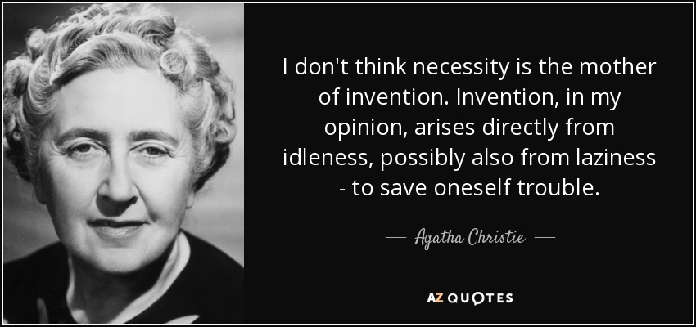

Slide 44

Happy Learning!

